Slide 1

Decentralized Insurance System
This presentation explores a decentralized insurance system designed to protect users against Ethereum (ETH) value drops, empowering them to navigate market volatility.
Made by the team: The Authority

Slide 2
Project Overview
Objective
Key Features
To offer insurance tokens on a secondary chain if ETH value drops, mitigating potential losses for users.
The system monitors ETH price, manages insurance policies, and automatically arranges payouts in case of a significant price drop.

Slide 3
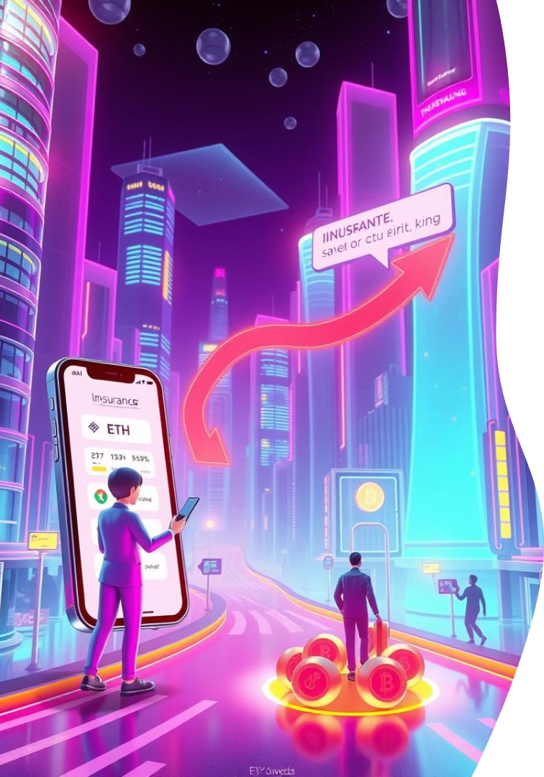
How It Works
1. Purchase Policy
Users buy an insurance policy and pay premiums in ETH.
2. Price Monitoring
A smart contract continuously monitors the ETH price.
3. Payout Trigger
If ETH crashes below a predefined threshold, users receive tokens on another chain.
4. Claim Processing
Claims are verified and processed for payouts.

Slide 4

Smart Contract Architecture
Insurance.sol
Manages policies and premium payments.
ClaimVerification.sol
Verifies and approves claims.
PayoutManager.sol
Handles fund distribution.
EventListener.sol
Detects events and authorizes payouts.

Slide 5

Frontend Implementation
Tech Stack
Components
Built with React.js and Ethers.js for seamless user interactions.
Issuing.jsx: Displays available policies.
Explainer.jsx: Provides clear explanations of the insurance model.
App.jsx: Central hub for user interactions.

Slide 6



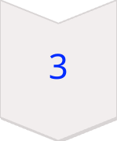

Smart Contract Interactions
Policy Creation
Users sign transactions to create insurance policies.
Premium Payments
Secure ETH transactions are recorded on-chain.
Claim Submission
Users request payouts via MetaMask.
Claim Verification & Payout
Handled through on-chain logic, ensuring transparency and security.

Slide 7

Limitations & Future Work
1
Currently, cross-chain payouts are not implemented due to time constraints.
2
We aim to expand support for payouts across major chains like Polygon, Arbitrum, and others in the future.
3
We plan to enhance the user interface with features like real-time ETH price tracking for greater transparency.

Slide 8
Tech Stack
Frontend
Smart Contracts
Blockchain
Deployment
React.js, Ethers.js, Vite.
Solidity, Hardhat.
Ethereum (Goerli/Sepolia Testnet).
MetaMask for user transactions.

Slide 9

Thank You
We appreciate your time and interest in our decentralized insurance system.

